Slide 1


Innovative Ingredient Expert
Ver. June 2025

Slide 2



About BK bio
History
Introduction
Core Technology
Product _R&D Ingredient
_Outsourcing Ingredient
5. Product _ Consumer Product_ODM
6. Vision

Slide 3
1
History
Company Profile
History
2000
2007
2008
2011
2012
2014
2015
2016
2017
2018
2019
2020
2021
2022
2023
Company establishment
Establishment of Seongnam Research Institute (Certified by Korea Industrial Technology Promotion Association)
Designated as INNO-BIZ venture company
Establishment of Jeju Research Institute
Selection of target companies for fostering mid-sized companies (Federation of Korean Industries)
Establishment of Hangzhou Branch in China
LOHAS certified company, Green certified company
Jeju factory completed / Headquarters moved to Jeju
Designated as Jeju local small strong enterprise
KMF Halal Certification
Organic Processed Food Certification / Food Safety Management Certification Standard (HACCP)
Vegetable Beverage, Vegetable Juice, Coffee, Liquid Tea Certification
Venture company/ISO 22000 certification
Food Safety Management Certification Standard (HACCP)
Other Infant/Toddler Food, Patient Food Certification
Rural Convergence Industry (6th Industry) Business Operator Certification
Selection of excellent (star) companies in Jeju region
Green technology certification, organic processing certification, GMP certification
Exclusive supply of raw materials for hangover cure “Kkaesukang”
Designation of promising small and medium-sized export companies
Brain Nutritional Supplement ‘Brain Mansaseong’ – TV Home Shopping Sale
Amway Japan Phytojuice Exports / Selected as Jeju Export 'Grand Prize '
2022 Global IP (Intellectual Property) Star Company Selection (Jeju)
Selection as leading companies
Completed clinical trial for fat reduction
Company Name | BK bio
CEO | Hyuk-joon Choi
Date of Establishment | Mar. 2000
Capital | USD 100,280
Business Area | Health functional biomaterials and finished product research and development with production facilities
Number of employees | 50
Location | [Head office/factory] 2706-38 Iljudong-ro, Gujwa-eup, Jeju-si (Yongam Marine Industry Complex) [Seoul Office] 4F, IB Tower, 19-7 Nambusunhwan-ro 350-gil, Seocho-gu, Seoul
Website | www.bkbio.com

Slide 4
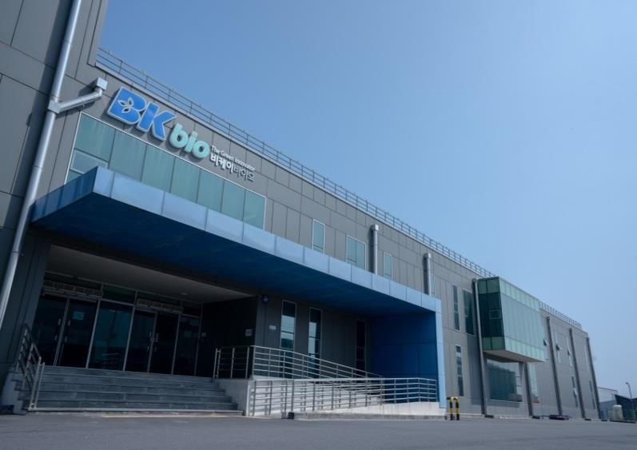
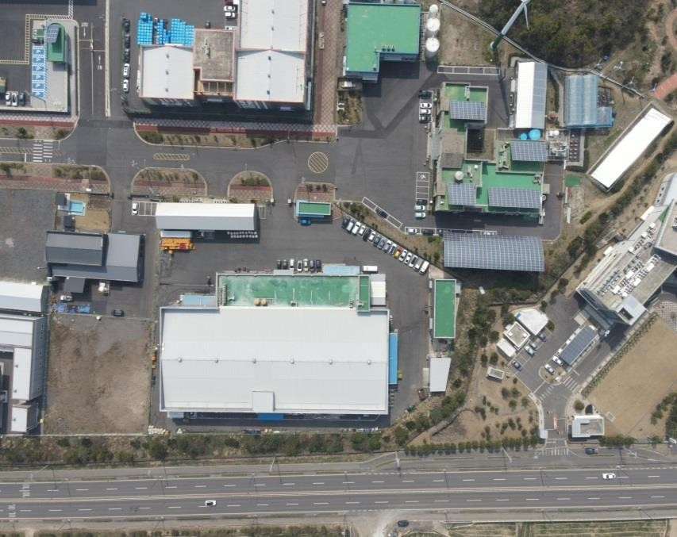
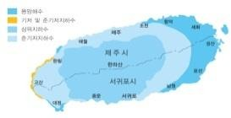

1
History_Location in Jeju island
Address: 2706-38, Iljudong-ro, Gujwa-eup, Jeju-si, Jeju-do ( Lava Seawater Industrial Complex )
Site area 10,383㎡ (3,146 pyeong)
Building area 5,979 m2 (1,811 pyeong)
Construction start date: November 2014
Construction Completion Date: July 2015
Factory Operation Date: November 2015

Slide 5




2
Introduction
Food Tech Solution
Patent registration: 42
(International patent registration: 3)
Patent application: 9
(International patent application: 4)
1
2
3
Production of food ingredient & consumer product
Research on eco-friendly natural new materials
Global functional food ingredient network

Slide 6
2
Introduction_Awards
Year | Awards | Awards organization
2023 | Selection of leading companies | Ministry of SMEs and Startups
2022 | Selected as a global IP (intellectual property) star company | Jeju Special Self-Governing Province
2021 | Jeju Island Export Grand Prize | Jeju Special Self-Governing Province
2021 | Minister of Small and Medium Size Enterprise Startups Award | Korea Industrial Technology Promotion Agency
2020 | Jeju National University Family Company AwardSelected as a Promising Small and Medium Enterprise for Export | Jeju National University Small and Medium Venture Business Department
2019 | Jeju Industrial Development Forum Best Practice Award | Jeju Regional Business Evaluation Team
2019 | Selected as an excellent (star) company in Jeju Island | Jeju Special Self-Governing Province
2018 | Plaque of Appreciation (LINC+ Training Project Technology Cooperation Sector) | Jeju National University
2017 | Minister's Award (Technical Innovation) | Ministry of Science and ICT
2017 | Sial Innovation Award | SIAL shanghai
2017 | Jeju Healthcare Representative Product Brand Marketing Award for the Leisure MICARE Business | J-Detox Award
2017 | MICARE Business Jeju Healthcare Representative Product Brand Excellence Award | J-Detox Award
2017 | Minister's Award (Small and Medium Enterprise Promotion) | Ministry of SMEs and Startups
2015 | Certificate of Appreciation for Current Student Work Experience | Semeyung University
2014 | Minister's Award (Trade Promotion) | Ministry of Trade, Industry and Energy
2013 | Venture Business Association President's Award | Venture Business Association

Slide 7
2
Introduction_Certificates
Year | Certification | Issuer
2023 | Vegan Certificate | Korea Vegan Certification Institute
2021 | Rural Convergence Industry Business Operator Certification | Ministry of Agriculture, Food and Rural Affairs
2020 | Venture Business Confirmation Certificate | Small and Medium Business Administration
2020 | Certificate of designation as a promising small and medium-sized export company | Ministry of SMEs and Startups
2019 | Organic Processing Certification | Hansol Agricultural, Forestry, Fisheries and Food Certification Center
2019 | Green Technology Certification | Ministry of Agriculture, Food and Rural Affairs
2019 | GMP | Gwangju Regional Food and Drug Safety Office
2018 | HACCP(Other infant/toddler food) | Korea Food Safety Management Certification Institute
2018 | Rural Convergence Industry (6th Industry) Business Operator Certification | Ministry of Agriculture, Food and Rural Affairs
2018 | HACCP (Food for patients) | Korea Food Safety Management Certification Institute
2018 | Certificate of Small and Medium Business | Ministry of Employment and Labor
2017 | HACCP(Coffee) | Korea Food Safety Management Certification Institute
2017 | Technology Innovation Small and Medium Enterprises (INNOBIZ) | Ministry of SMEs and Startups
2017 | HACCP(Fruit and vegetable Juice) | Korea Food Safety Management Certification Institute
2017 | HACCP(Liquid tea) | Korea Food Safety Management Certification Institute
2017 | HACCP(Fruit and Vegetable Beverage) | Korea Food Safety Management Certification Institute
2016 | Jeju Local Small and Medium Business Certificate | Jeju Special Self-Governing Province
2016 | IP Star Enterprise Certificate | Jeju Chamber of Commerce and Industry

Slide 8



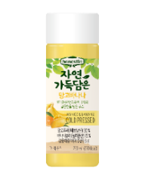
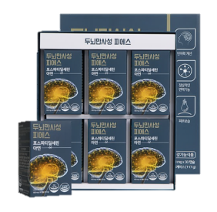
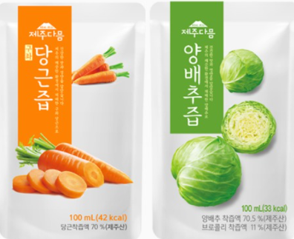
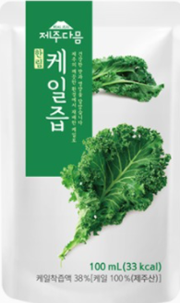
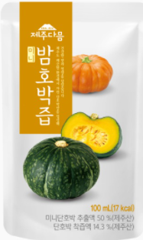
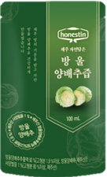




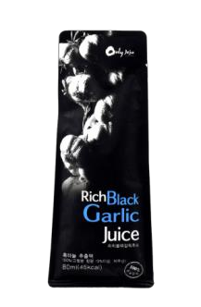
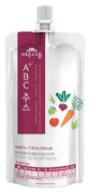
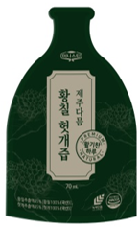
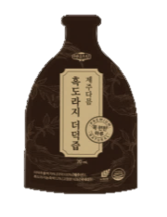
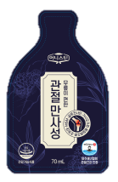
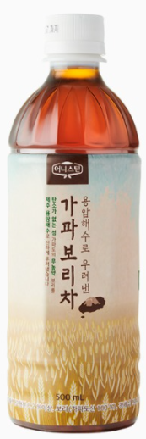
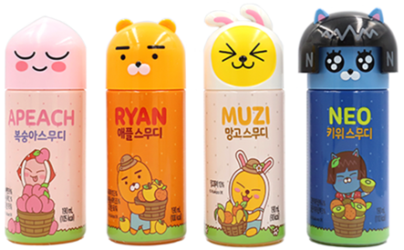
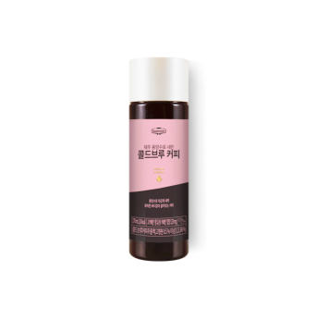
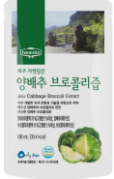
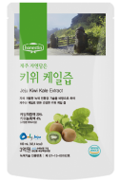
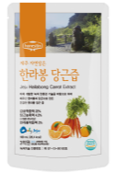


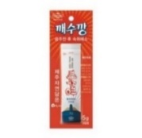


































2
Introduction_Product Overview
Extract : Dandropanax. Green tea...
Concentrates : Mandarin, Carrot, Cabbage...
Functionals : Milk phospholipid, Seaweed
ext, Fiber...
Blended ingredients : Custom made, Dextrin,
Vit C mixture...
Outsourcing : Phospholipid, Fiber, Antioxidant..
소
재
완
제
Clients

Slide 9
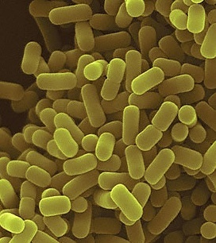
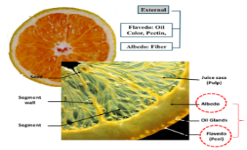
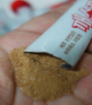

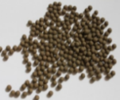
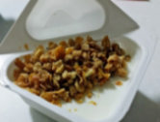


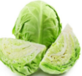
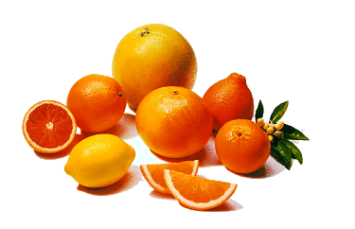
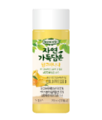
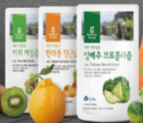



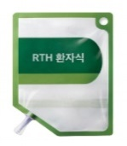

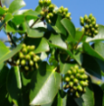
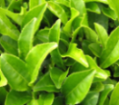





3
Core Technology_Production and QC System
Advanced production system from raw materials to products
Analysis of ingredients, active component, and microbials at R&D Lab (9 Researchers)
[Health Food GMP]
[Bioconversion & Fermentation]
[Functional ingredients]
[Immune polysaccharides]
[Nutrition Food, HMR]
Bio-
conversion
Extraction
[Supercoli®, high value-added vegetable processed products]
Isolation
Purification
Processing
[Health juice, Health drink]
BioLabtory
[Concentrate]
Area of ​​application
Technology and Health functional food ingredient Area

Slide 10

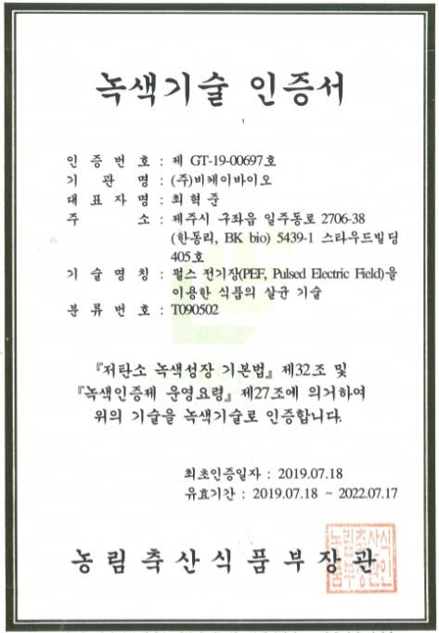
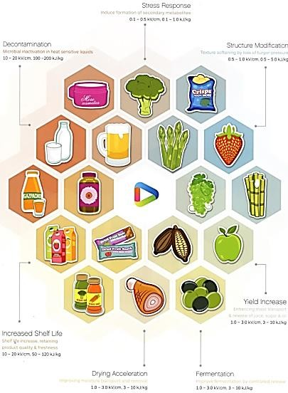







3
Core Technology_Pulsed Electric Field Technology
Increasing extraction yield and induce intracellular biochemical reactions by destroying plant and animal cell membranes by pulse energy
Obtained green technology certification from the Ministry of Agriculture, Food and Rural Affairs for 20% reduction in energy and carbon emissions
Patented technology for optimal pulse energy generation conditions for cell membrane disruption, extraction, and biochemical reaction induction
Increase extraction yield
Pasteurization
Texture Improvement
Improve juice yield
Improve storage properties
Increase drying yield
Fermentation optimization
Food pasteurization technology using pulsed energy (PEF)

Slide 11
3
Core Technology_R&D Flow
Raw material
Precursor
Selective
Bioconversion
Output
Efficacy
Application
Citrus /
Broccoli
Glucoraphanin
Sulforaphane
Cognition
Healthfood
Pectin
Naturals
By products
Immune Polysaccharide
Immnue
Anti cancer
Functional ingredients
Glucose
Enzyme
Fermentation
Galatose
By products
PEF
Oligomer
Lactobacillus
Anti wrinkle,
Moisturizing
Natural medicine
Rhamnose
Preventative medicinal food leader
Preventival medicinal food based on daily consumption
Purification
Safe

Slide 12

3
Core Technology_Ingredient R&D
Seaweed functional ingredient· Improvement of intestinal immunity and intestinal function
In vivo test
Cognitive, memory function improvement
Food choline alfoscerate
Milk phospholipid
Clinical trial in progress
Broccoli Pulse Energy Extract· Cognitive memory,
muscle strength,
Joint/menopause
Clinical trial in progress
Milk phospholipid
: Skin moisturizing &
Anti wrinkle
Clinical Trial Completed
Hair loss prevention, hair growth
In vivo test completed
Jeju tangerine extract
· Reduceing body fat, diet
Development of new sterilization
- PEF, cold plasma, light pulse
New Probiotics from cabbage
- Immunity & Body Fat Reduction
Clinical Trial Completed

Slide 13
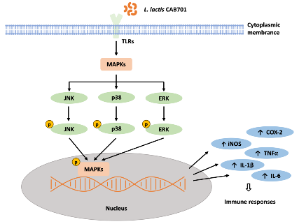
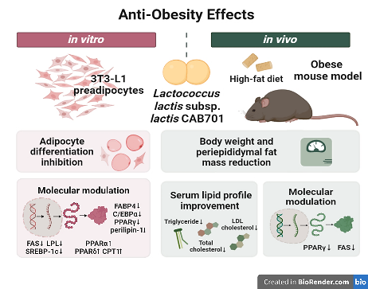
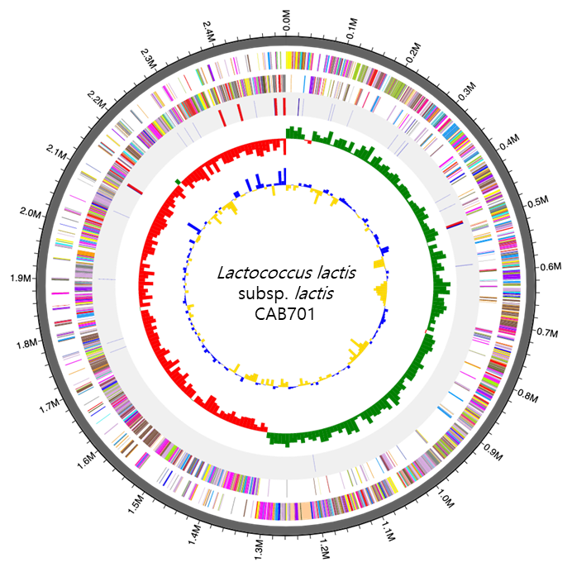
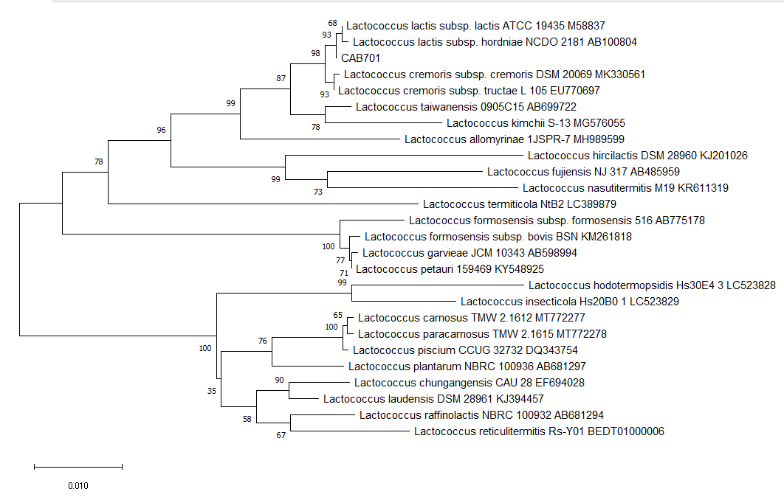
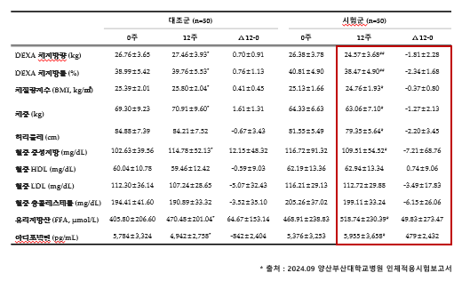
4
Product_R&D Ingredient
Anti-obesity body fat reduction
Isolation of probiotics, Lactococcus lactis sub ( JBK 329 ) from Jeju cabbage.
Clinical test result
CAB701 Structure and Properties
Immune stimulating effect, anti-obesity effect
Immune stimulating effect & anti-obesity effect
Results of human clinical efficacy tests
▲ Lactococcus lactis subsp. lactis CAB701 identification
Significant decreases were confirmed in six body fat improvement indicators: weight, body mass index (BMI), waist circumference, body fat mass, body fat percentage, and blood triglycerides.
It is suitable for survival in the intestinal environment and has better resistance to acid, bile, and pancreas and adhesion to Caco-2 cells than strains of the same species.
Reduces oxidative stress and inflammation, which are important for maintaining overall health and preventing chronic disease.
Stimulates immune response by influencing the expression of key inflammatory mediators and activating signaling pathways involved in immune response.
Completed clinical trial and applied to the Ministry of Food and Drug Safety for its body fat reduction effect
“Application to the Ministry of Food and Drug Safety (KFDA): Functional ingredient for reducing body fat”
“Exclusive supply contract for Brazil and Thailand market”

Slide 14

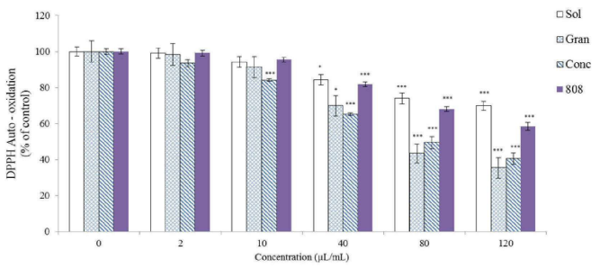
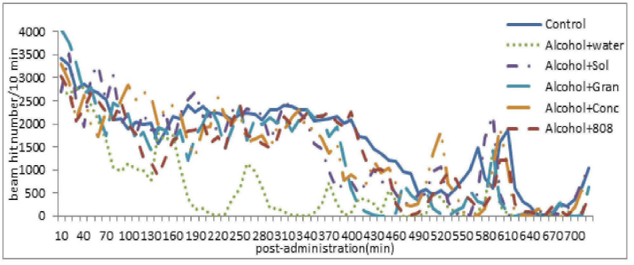
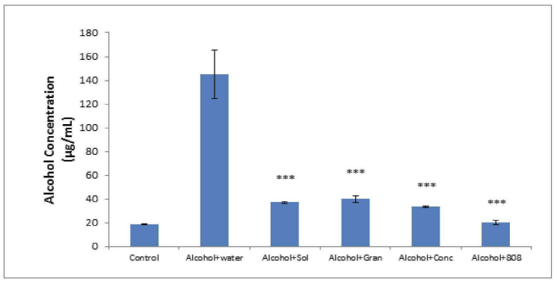
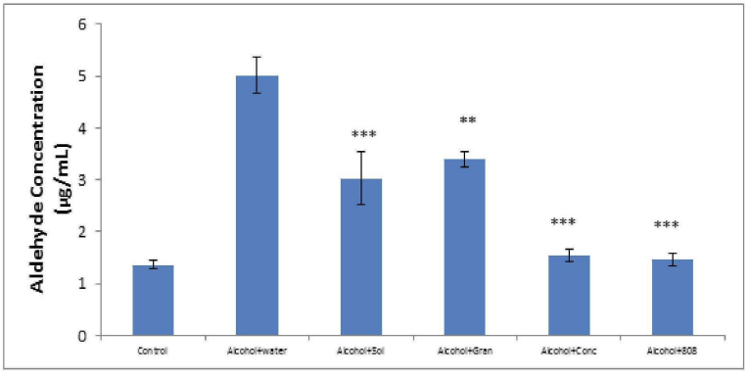
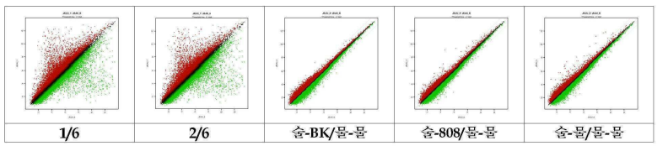
4
Product_R&D Ingredient
Anti-hangover
Hangover relief and improvement of liver health
Characteristics and Efficacy Data
Antioxidant effect, anti-hang over
Antioxidant effect
antioxidant activity of Dendropanax morbiferus seaweed complex extract
Dendropanax morbiferus and Seaweed extract contains Ecklonia cava extract, Gelidium amansii extract, Sargassum fusiforme extract, Sargassum fulvellum extract, and Undaria pinnatifida extract. In addition, it contains a plant complex extract mixed with Dendropanax morbiferus extract and green tea extract
Animal testing
Behavioral pharmacology experiments to measure motor activity, quantify blood acetaldehyde/alcohol, and gene expression, it was confirmed that the concentrated extract of Dendropanax morbiferus and seaweed extract significantly reduced factors related to immune and inflammatory responses increased by alcohol in liver cells.
Key Patents
Patent | Year
A composition for relieving hangovers or preventing or treating alcoholic liver disease, containing seaweed complex extract and plant complex extract as active ingredients (registered) | 2019
Composition for improving, preventing or treating fatty liver disease containing seaweed complex extract and plant complex extract as effective ingredients (registered) | 2019
Composition for improving, preventing or treating alcoholic gastrointestinal disease containing seaweed complex extract and plant complex extract as effective ingredients (registered) | 2019
Hangover relief drink base
“Exclusive supply contract to Lotte”
“Anti-hangover relief clinical trial in 2025”

Slide 15
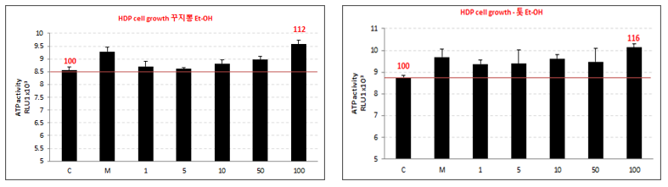
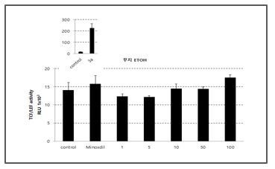
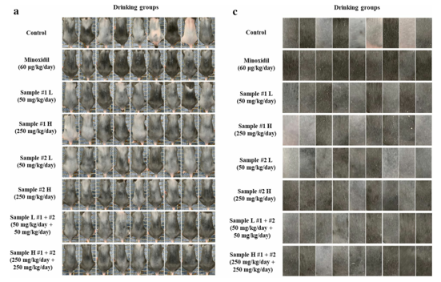
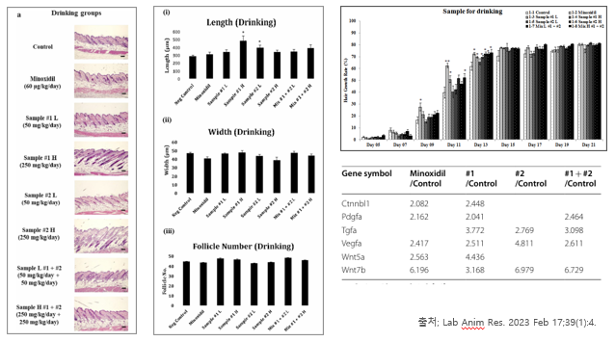
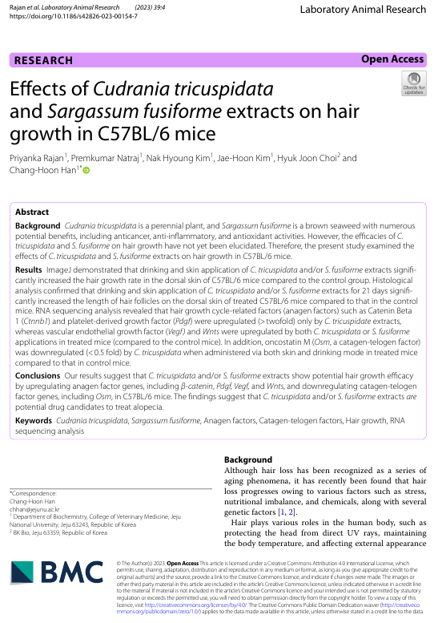



4
Product_R&D Ingredient
Hair growth
Hair health ingredient extracted from Maclura tricuspidata and Sargassum fusiforme
Hair growth promotion and hair loss improvement and prevention effects(Lab Anim Res, 2023)
Characteristics and Efficacy Data
Promotes hair growth, improves hair loss and prevents hair loss
Dermal papilla cells test
Promote proliferation of Dermal papilla cells and confirms increase of β-catenin
Safe natural substance
The efficacy of Maclura tricuspidata and Sargassum fusiforme for improving hair health was confirmed through hair papilla cell and animal testing, with effects on hair growth and health promotion.
Testing
Efficacy data
Hair growth scores increased
Hair growth phase ratio and hair thickness increased.
Application number 10-2022-0095819
10-2022-0095819
  Lab Anim Res, 39(1), 1-12.
Hair health functional ingredient
“Exclusive supply contract with Brazil in 2025 and exporting”

Slide 16



4
Product_Outsourcing Ingredient
Background
Portfolio
BK bio sales office
Dairy companies :
Seoul Dairy
NamYang Dairy
YonSei Dairy
Pasteur
Dr.Chung’s food
…
Foods & Pharm companies :
CJ
LG
Daesnag
KT&G
Nongshim
Pulmuone
Ottogi
Dongwon F&B
Nutribiotech
Lyntz
…
Cosmetic companies :
Amore pacific
LG
Dermatology
…
Phytonutrient
Distribution & Logistics
Functional Foods
Organics
BK bio
Clinical & Functional Cosmetics
Functional
Lipid
Nanoemulsion &
Microcapsulation

Slide 17

4
Product_Outsourcing Ingredient
Process
Importing
of functional
food ingredients
&
Nutraceuticals
Licensing & registration
Licensing
Sourcing
new material
&
technology
Introducing
BK bio
Creating
with suppliers
R&D & MKT Consulting
of advanced food ingredients,
food products & organics.
New Products
&
Into Market
with customers

Slide 18


5
Product_Consumer Product
Honestin® BK bio brand, OEM, ODM production and sales
Fresh Vegetable Juice / Healthy Juice
Vegetable Yogurt
Health functional food
1
2
3
1

Slide 19

5
Product_Honestin® Brand
Product Overview
Product Image
Product Name | Green tangerine juice with tangerines
Food Type | Fruit Juice
Product Concept | NFC juice made with tangerines and green tangerine that are good for our children's health NFC 95% Jeju-grown Pure fruit juice without heating or adding a drop of water to keep the nutrients intact. Full of nutrients necessary for students with a lot of growth and brain activity Contains Jeju-grown green tangerines and matured tangerines for a sweet and sour taste. No water, synthetic flavoring, or sugar added.
Target | Children and youth
Ingredients | Tangerine juice 90.0% [100% tangerine (Jeju)], Green tangerine juice 5% [100% green tangerine (Jeju)], Apple juice concentrate, Fructooligosaccharide
Volume | 100ml / Pouch
Shelf Life | 12 months at room temperature

Slide 20

5
Product_Honestin® Brand
Product Overview
Product Image
Product Name | Green tangerine juice with tangerines
Food Type | Fruit Juice
Product Concept | NFC juice made with Green tangerine and tangerines that are good for our children's health NFC 95% Jeju-grown Pure fruit juice without heating or adding a drop of water to keep the nutrients intact Full of nutrients necessary for students with a lot of growth and brain activity Contains Jeju green tangerines and tangerines for a sweet and sour taste. No purified water, synthetic flavoring, or sugar used
Target | Children and youth
Ingredients | Tangerine juice 90.0% [100% tangerine (Jeju)], Green tangerine juice 5% [100% green tangerine (Jeju)], Apple juice concentrate, Fructooligosaccharide
Volume | 340ml / PET
Shelf Life | 12 months at room temperature

Slide 21


5
Product_Honestin® Brand
Product Overview
Product Image
Product Name | Vegetable Yogurt Coconut _ Apple Mango, Hallabong, Cheonhyehyang, Blueberry (4 types)
Food type | Probiotic drink
Product Concept | A meeting of coconut cream and plant-based lactic acid bacteria This is a healthy plant-based yogurt made by fermenting coconut cream instead of milk so that anyone can drink it without any discomfort. It is made healthier by using plant-based lactic acid bacteria strains.
Target | People who want to enjoy plant-based yogurt anytime, anywhere People who have trouble digesting milk
Ingredients | Coconut cream 25%, Fructooligosaccharide 8%, etc.
Volume | 120ml/bottle 190ml/bottle
Shelf Life | 15 days at a refrigerated condition

Slide 22








5
Product_Honestin® Brand_Healthfood for brain
Product Overview
Features
Product Name | Brain healthfood Smart (Phosphatidylserine & Theanine)
Food Type | Health functional food
Functionality | Phosphatidylserine 300mg Improves cognitive function that has declined due to aging. Skin moisturizing 2) Theanine 200mg Relieves tension caused by stress (Based on the Ministry of Food and Drug Safety's notification standard)
Packing | 30 packs (2g per pack) for 1 month / Powder stick type
Consumer Price | 66,000 KRW
Recommended Customers | People who often forget their passwords or cell phones People who have experienced frustration because they can't remember names or words they know People who can't think of words during conversations People who need brain nutrition People who feel tense due to academic or work stress People who have accumulated tension due to stress in general
Domestically manufactured highest purity, phospholipid content of 99.5% or more PS 300mg contained
Domestic patented Croda’s Highest purity PS raw material used
PS 300mg
Contains 200mg of theanine for stress management, one of the causes of cognitive decline
Theanine 200mg
A product meticulously designed and manufactured, including the raw materials, by BK Bio a phospholipid specialist, and Croda
Chamomile
Contains 3 herbs that help relieve stress through harmonizing the nervous system
Helps relieve stress and improve cognitive ability through harmonizing the nervous system
Lemongrass
Hibiscus

Slide 23

5
Product_Honestin® Brand_Healthfood for Joint
Product Overview
Features
Product Name | All that joint
Food Type | Health functional food
Functionality and Ingredients | 1. Main ingredient MSM( US origin, 1,500mg) 2. Sub ingredients Dendropanax morbiferus and Seaweed extract Eleutherococcus senticosu extract S. Borealis extract concentrate 3. Jeju lava seawater
Specification | 10 pouches / 70ml / Shelf life 2 years
Recommended Customers | People with recurrent and persistent joint pain People with pain in joints such as hands, arms, shoulders, and knees People who have tried various things but have not seen any results
Consumer Price | 50,000 KRW
1. Contains 1,500mg of premium MSM from the USA - Meets the daily recommended amount of MSM, a functional ingredient approved by the Ministry of Food and Drug Safety
2. Jeju seaweed
Ecklonia cava, Sargassum fusiforme, Ssargassum, Gelidium amansii, S. Borealis extract
3. Using Lava Seawater instead of normal water
Lava seawater containing minerals and nutrients, naturally filtered through basalt layers for 400,000 years
4. Jeju Haenyeo Association Joint Health Certified
5. No sugar, No oligosaccharide
6. One pack per day, fast-absorbing liquid product

Slide 24

5
Product_Honestin® Brand_ Healthfood for immune
Product Overview
Features
Product Name | All that immune
Food Type | Health functional food
Functionality and Ingredients | 1. Main ingredient Zinc (US origin, 4mg) 2. Organic Burdock, Shiitake mushrooms Carrot, Radish green, Radish 3. Jeju lava seawater
Specification | 10 pouch / 120ml /Shelf life 2 years
Recommended Customers | Those who need normal immune function and cell division Those who need health management due to decreased physical strength and lack of vitality Those who are overly active or busy with work - Those who need health promotion
Consumer Price | 50,000 KRW
Contains 4mg of zinc gluconate from the United States - Meets the recommended daily intake of zinc, a functional ingredient recognized by the Ministry of Food and Drug Safety
Vegetable water product made by brewing organic burdock, shiitake mushrooms, carrots, radish greens, and radishes in the optimal mixing ratio - Certified organic processed food
3. Uses Jeju lava seawater instead of purified water
Lava seawater containing minerals and nutrients
naturally filtered from basalt layers for 400,000 years
4. One pack per day, a liquid product that is quickly
absorbed

Slide 25


5
Product_ODM for emart
[ emart Organic ABC Juice ]
Whole organic vegetable juice
NFC juice
Jeju organic beet, carrot
750ml
28 days in a refrigerator
[ emart Organic CCA Juice ]
Whole organic vegetable juice
NFC juice
Jeju organic carrot, cabbage
750ml
28 days in a refrigerator

Slide 26

5
Product_ODM for Seoul Dairy
Product Overview
Product Image
Product Name | Seoul Dairy Vegetable Yogurt - Coconut
Food type | Probiotic drink
Product Concept | Coconut cream and plant-based lactic acid bacteria This is a healthy plant-based yogurt made by fermenting coconut cream instead of milk so that anyone can drink it without any discomfort. It is made healthier by using plant-based lactic acid bacteria strains.
Target | People who want to enjoy plant-based yogurt anytime, anywhere People who have trouble digesting milk
Ingredients | 50% coconut cream, coconut cream powder, isolated soy protein, oligosaccharide, glucose
Volume | 120g/Pouch
Shelf Life | 1 year under a room temperature

Slide 27

5
Product_ODM for Starbucks
Product Overview
Product Image
Product Name | Vegetable Yogurt Coconut _ Apple Mango, Hallabong (2 types)
Food type | Probiotic drink
Product Concept | Coconut cream and plant-based lactic acid bacteria This is a healthy plant-based yogurt made by fermenting coconut cream instead of milk so that anyone can drink it without any discomfort. It is made healthier by using plant-based lactic acid bacteria strains.
Target | People who want to enjoy plant-based yogurt anytime, anywhere People who have trouble digesting milk
Ingredients | Coconut cream 25%, Fructooligosaccharide 8%, etc.
Volume | 190ml / Bottle
Shelf Life | 21 days at a refrigerated condition

Slide 28











5
Product_ODM customers
| PHYTO JUICE
| 4 types of puree made as is (squash/ banana/apple/pear/mixed vegetables)
| Baby Prune / Pear /
Balloonflower Juice
Sales by: Amway Japan, Taiwan
- 100mL· ABC juice for detoxification
- Thin film evaporation
concentration technology applied - - Minimized taste and aroma loss
- Distributed in Japanese & Taiwan
Amway
Sales by : ORGA
Sales by : Bebest
- 100mL
- Maintaining fresh taste with hot
water sterilization method
- Puree type fruit juice for children
- 70mL
- Juice for babies and children
- Prune : Gut Health
- Pear/ Balloonflower :
Bronchial Health
| Organic Juice

Slide 29


6
Vision
Food Tech Solution
Customer network : Custom made
New sourcing
Blending
HACCP
GMP
Organic
HALAL
Green Technology
Global supply
network
Advanced Process :
Extraction
Concentration
Mixing
R&D with
customers

Slide 30

Headquarters/Factory 2706-38, Iljudong-ro, Gujwa-eup, Jeju-si, Jeju Special Self-Governing Province (Yongam Marine Industry Complex), ROK
Seoul Sales Office 4th floor, IB Tower, 19-7 Nambusunhwan-ro 350-gil, Seocho-gu, Seoul, ROK
Tel +82-(0)64-753-8600 Fax : +82-(0)64-782-6188 ㅣ www.bkbio.com

